Slide 1

Green Pace
Security Policy Presentation
Developer: Katelin Kaneen

Slide 2

OVERVIEW: DEFENSE IN DEPTH
Security policy is important to implement to manage risks, protect data and have compliant code.
Notes:
Our security policy is going to overview the importance of implementing security everystep of the way to implement better risk managmet, protect data and have code that is consistent and up to compliant rules and standards.

Slide 3
THREATS MATRIX
Likely STD-005-CPP STD-008-CPP STD-010-CPP | Priority STD-006-CPP
Low priority STD-006-CPP | Unlikely STD-001-CPP STD-002-CPP STD-003-CPP STD-004-CPP STD-009-CPP
Notes:
Secure coding comes with levels of threats. Here are examples of threats and the level of priority they may bring.

Slide 4
10 PRINCIPLES
1. Validate Input Data: STD-001-CPP | STD-002-CPP | STD-003-CPP
|STD-004-CPP |STD-007-CPP |STD-010-CPP
2. Heed Compiler Warnings: STD-001-CPP
3. Architect and Design for Security Policies:STD-006-CPP
4. Keep It Simple: STD-003-CPP|STD-004-CPP|STD-007-CPP|STD-008-CPP
5. Default Deny: STD-006-CPP
6. Adhere to the Principle of Least Privilege:
7. Sanitize Data Sent to Other Systems: STD-003-CPP
8. Practice Defense in Depth:STD-006-CPP
9. Use Effective Quality Assurance Techniques: STD-003-CPP
10. Adopt a Secure Coding Standard: STD-001-CPP|STD-002-CPP|STD-003-CPP
Notes:
10 Principles that is essential in building a reliable software system. 1: validate input data is great way to validate user inputs aren’t malicious and is honest input.
2: heed compiler warnings, just as it says, to heed to security warnings.
3: Architect and Design for Security Policies; this is taken care of during the design and architectural phase of software development. By implementing defense in depth, threat modeling and secure authentication and testing.
4: keep it simple; the goal here is to ensure design and security system is put simply. Its not only easier to maintain, it minimizes vulnerabilities.
5. Default Deny: authorization of access is granted to only those who have access. Default to deny will always default to those who don’t have that access by creating security mechanism and control access.
6. Adhere to the principle of least privilege: Users have minimum access to accomplish tasks they may be required to do, this helps minimize risk but sets it to a need-to-know basis.
7: Sanitize Data sent to other systems: process of sanitizing data prior to sending out to external systems. Minimizes malicious data being transmitted to external systems.
8: Practice defense in depth: as mentioned earlier defense in depth implements multilayered security measures to protect systems data from threats.
9. Use effective QA techniques: implementing vigorous QA steps to ensure security are maintained and implemented.
10. Adopts a secure coding standards: ensures proper security coding standard is implemented in practice.

Slide 5
CODING STANDARDS
Rule | Severity | Likelihood | Remediation Cost | Priority | Level
STD-001-CPP | High | Unlikely | Medium | P12 | L2
STD-002-CPP | Low | Unlikely | Low | P3 | L3
STD-003-CPP | Low | Unlikely | Low | P3 | L3
STD-004-CPP | Low | Unlikely | Medium | P2 | L3
STD-005-CPP | Low | Probable | Low | P6 | L2
STD-006-CPP | Low | Unlikely | High | P1 | L3
STD-007-CPP | Low | Unlikely | Medium | P2 | L3
STD-008-CPP | Medium | Probable | Medium | P8 | L2
STD-009-CPP | Medium | Unlikely | Medium | P4 | L3
STD-010-CPP | High | Likely | High | P9 | L2
Notes:
STD-001-CPP: Do not define a C-syle variadic function(reducing usage of incorrect variadic functions by setting up error checks while ensuring code is compatible.
STD-002: Do not declare or define a reserved identifier(code that doesn’t declare a reserved identifier means that will need identifier that can reduce errors.
003: Never Qualify a reference type with const or volatile(no ambiguous code will lead to clear intent)
004: Do not write syntactically ambiguous declarations(continuous monitoring wouldn’t be possible without clear data)
005: Overload allocation and deallocation function as a pair in the same scope(Memory allocation is important because important data that is needed should be strategized)
006: Avoid information leakage when passing a class object across a trust boundary(Continuously monitoring will prevent data from leaking as well as risk of breached data by unauthorized user)
007:Avoid cycles during initialization of static objects(Continuously monitoring code for constancy and efficacy check)
008: Do not depend on the order of evaluation for side effects(No ambiguous code for clarity if multiple side effects are needed)
009: Do not cast to an out of range enumeration value(continuous monitoring will ensure the value didn’t result in unspecified and ensure that it was in range)
010: Guarantee that container indices and iterators are within the valid range(continuous monitoring will allow to always check for the the value is in range and prevent it from going out of bounds.

Slide 6
ENCRYPTION POLICIES
Encryption in Rest: Used to block unauthorized users from accessing encrypted data. This involves setting up secure password to grant access as well as setting up boundaries from security attacks.
Encryption at Flight: Data that is being encrypted while processing between devices and network. Higher risk for security breaches because security measures need to be in place to prevent unauthorized users to intercept data.
Encryption in Use: When processing encryption as the CPU is in use. This allows the code to no have to be decrypted prior, making security higher.

Slide 7
TRIPLE-A POLICIES
Authentication: Set up username and password as well as a system such as two step verification to ensure when login in that it’s the correct authorization to get in.
Authorization: Setting up controls for a user and what they may have access to.
Accounting: Combine all of the above and to audit user logins and to ensure that the duration that is placed in is used for their login abilities only.

Slide 8
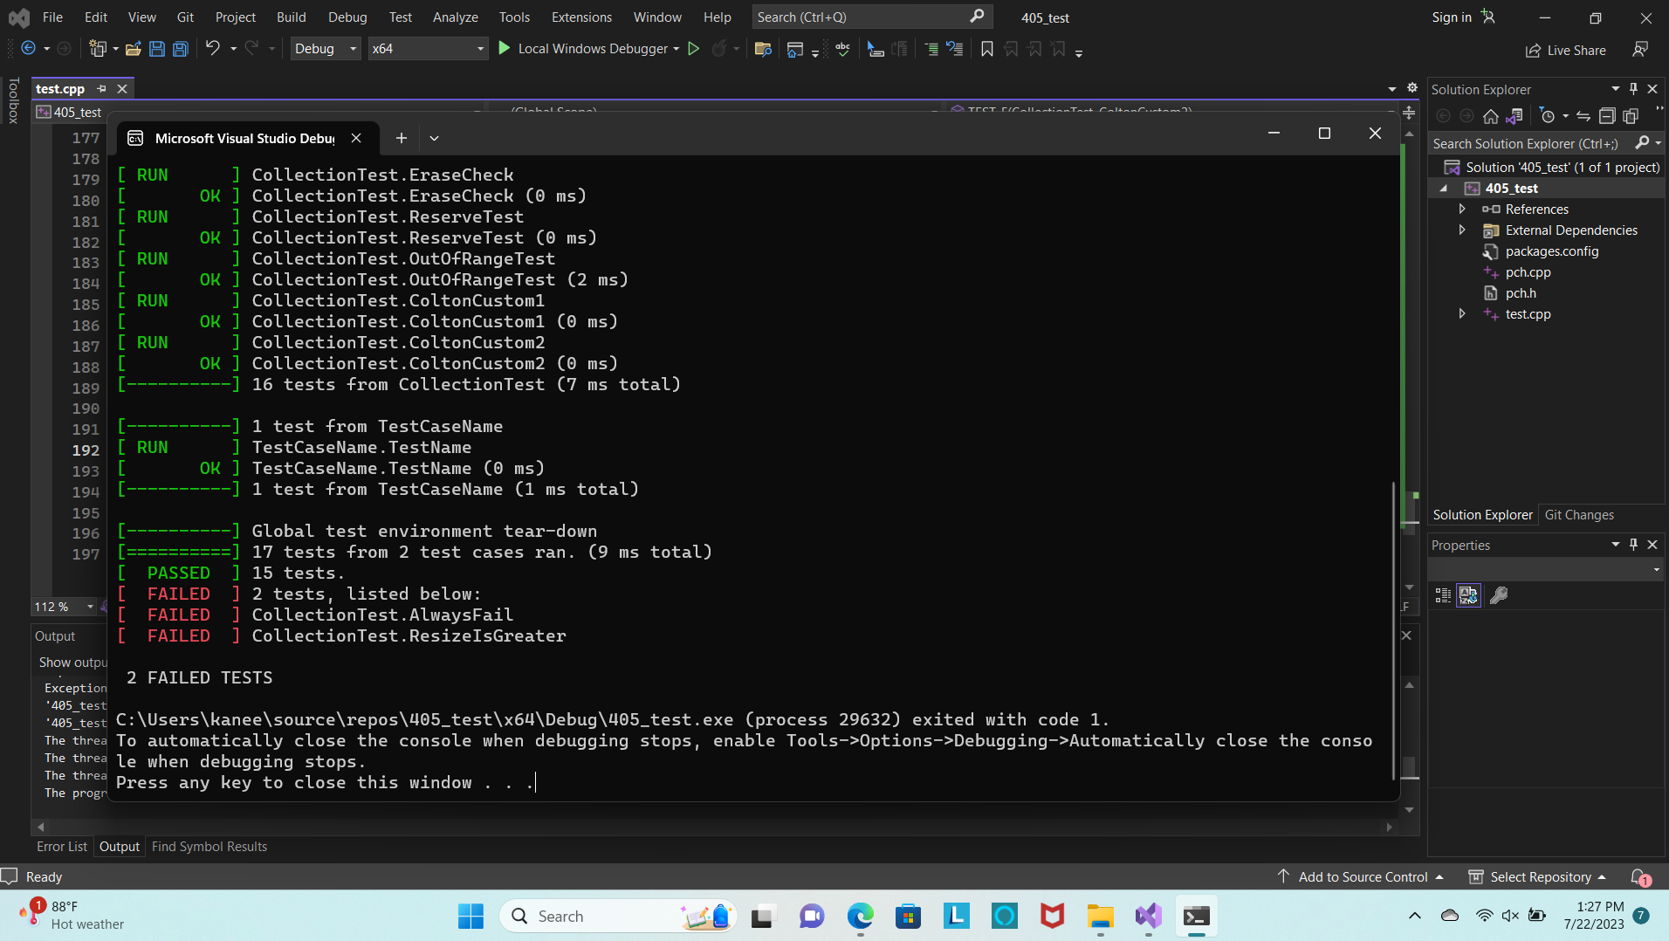
Unit Testing
Our unit testing is continuously monitoring for errors to ensure security measures at placed in.

Slide 9

AUTOMATION SUMMARY

Slide 10
TOOLS
DevSecOps combines Development, Security and Operations teams to integrate security every step of the SDLC. By continuously focusing on any updates that need to be implemented, to ensure security measures are taken place.
Various tools that will perform automation checks as well as just keeping your code clean from security errors. Clang for example has features for developers that will benefit verify and test stage where it can perform fast checks and automation checks for formatting and more. CodeSonar is another developer tool within DevSecOps and it is beneficial on the design side where security measures can be ensure its put into place.
Notes:
DevSecOps(Development, Security and Operations) work together to integrate security in every step of the software development lifecycle. Various tools can perform automation checks to keep it error free. Clang is a tool that allows devdelopers to test stage where it can perform fast checks and automation checks for formatting. CodeSonar is another tool that is on the design side where security measures can be place.

Slide 11
RISKS AND BENEFITS
Act Now | Wait
Speed and efficiency | More expensive when caught later, time and money
Fewer errors | Not catching all errors before released
Implementing security from designing stage | Higher Security risks

Slide 12
RECOMMENDATIONS
Be prepared for the unknown
Actively monitoring and auditing
Don’t wait

Slide 13
CONCLUSIONS
By adopting multiple standards Green Pace can implement coding standards that maintain and minimize further risks. STD-003-CPP, STD-006-CPP, and STD-004-CPP is a good start to implement standards into best practice.
Notes:
Architect and Design for Security Policies, keep it simple and
Adhere to the principle of least privilege are great standards to start implementing for best practice.

Slide 14
REFERENCES
Beddoe, W. (n.d.). Understanding the hierarchy of principles, policies, standards, procedures, and guidelines. LinkedIn. https://www.linkedin.com/pulse/understanding-hierarchy-principles-policies-standards-wally-beddoe/
Clang 18.0.0git documentation. Overview - Clang 18.0.0git documentation. (n.d.-b). https://clang.llvm.org/docs/ClangTools.html#:~:text=Clang%20Tools%20are%20standalone%20command,automatic%20formatting%2C%20refactoring%2C%20etc.
Sonarsourcestatic code ANALYSISSINCE2008. SonarSource Rules. (n.d.). https://rules.sonarsource.com/

